Slide 1
CAPSTONE-PROJECT
Based on A Health Care Insurance Company
Presented By Rohit Thapa

Slide 2
Introduction
The purpose of this capstone project is to provide a complete guide for the data Engineering team to understand and implement the features and functions as per required for the Health Care Insurance Project to enhance revenue and customer understanding from big data ecosystem to improve customer satisfaction.

Slide 3
Software included
AWS S3
AWS Redshift
Databricks
Pyspark
Jira
GitHub

Slide 4
Activities to be performed
Scrum (Tracking)
Dataset Creation
Data Cleaning
Solve the use cases
Upload to redshift
1
2
3
4
5

Slide 5
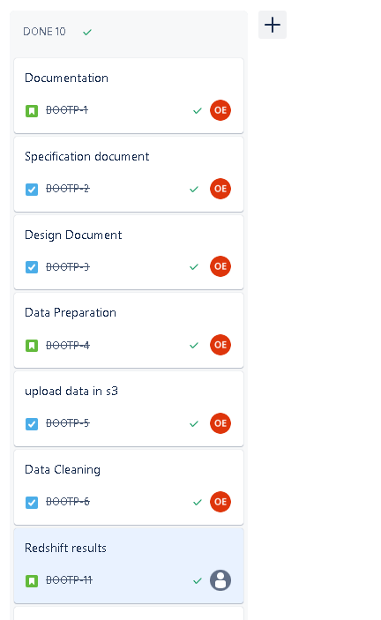
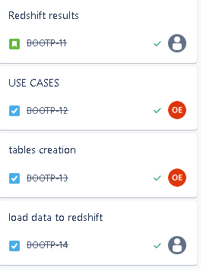
Jira scrum for tracking tasks

Slide 6
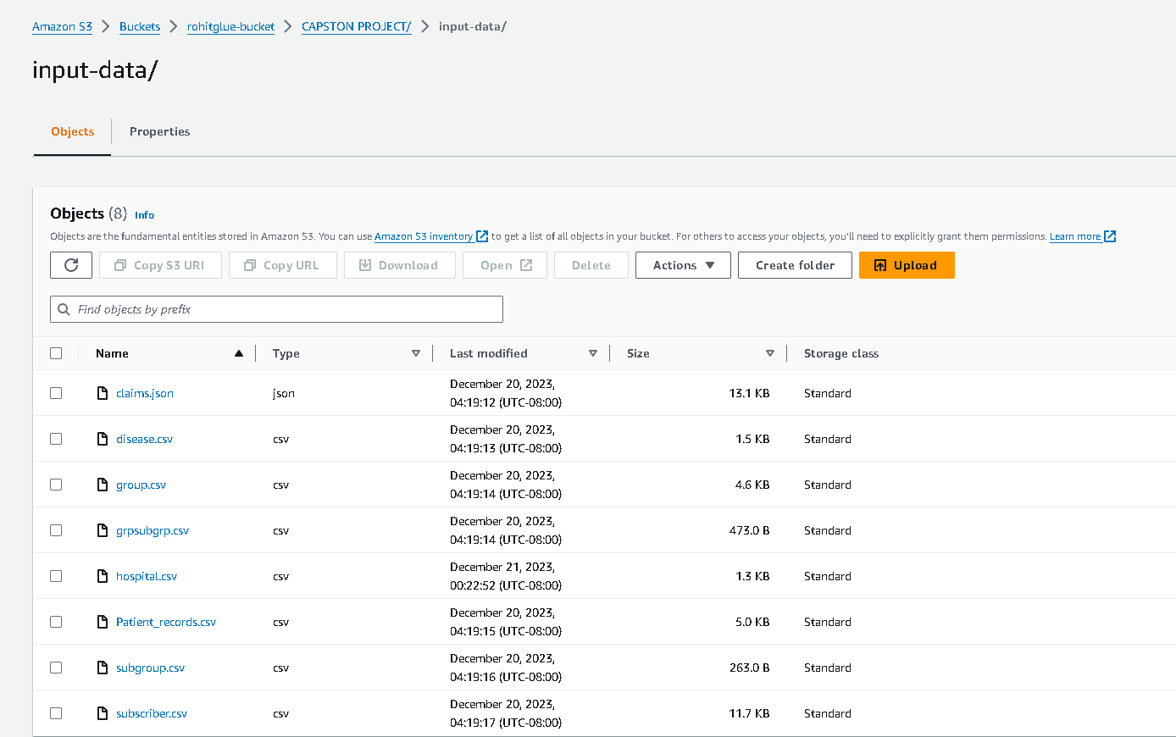
Dataset Creation

Slide 7
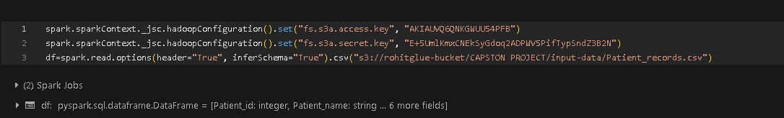
Dataframe to read from s3
Given screenshot presents the dataframe that reads file from s3

Slide 8
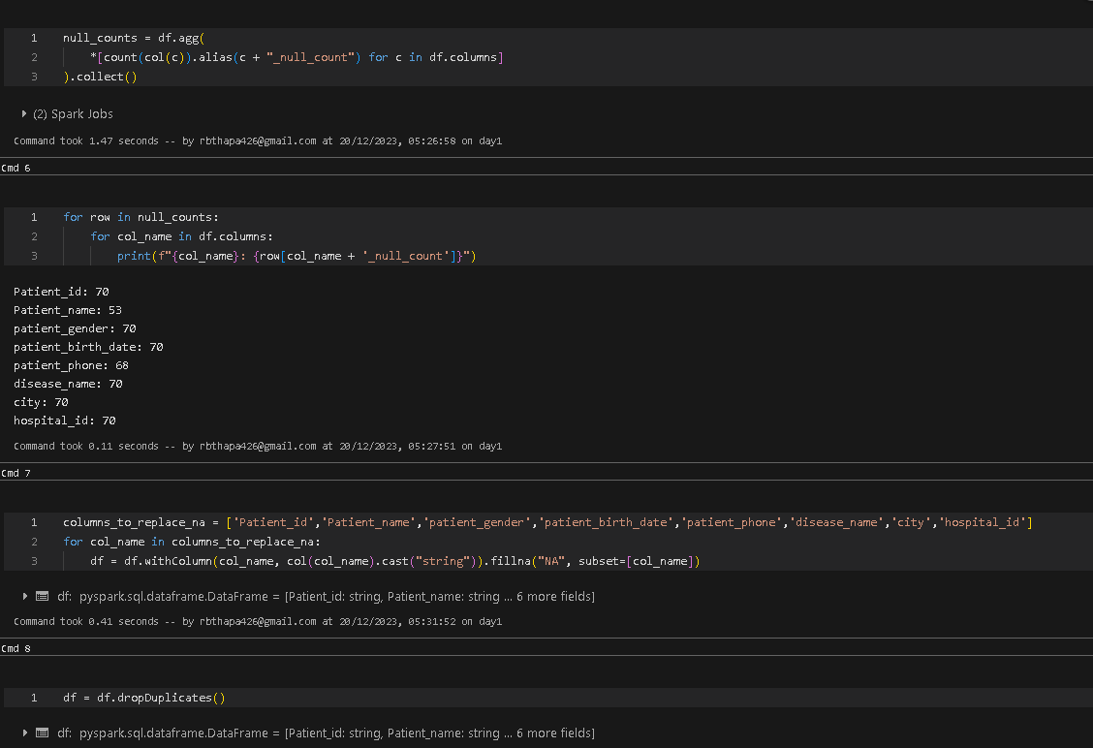
Data Cleaning
Databricks was used for data cleaning process and creating pipeline
Given below screenshot represents code to clean data

Slide 9
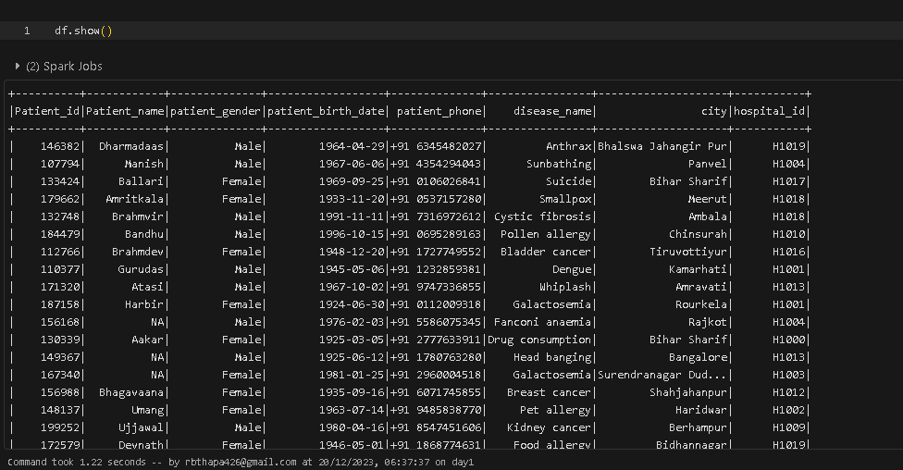
Cleaned data screenshot
Below screenshot represents cleaned data of Patients.csv file from Databricks

Slide 10
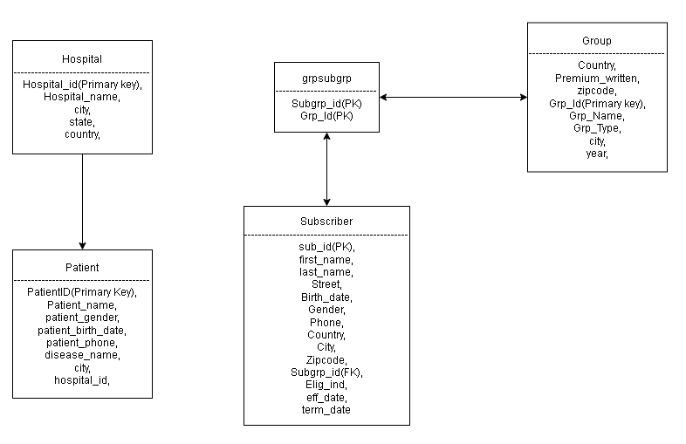
ER Diagram

Slide 11
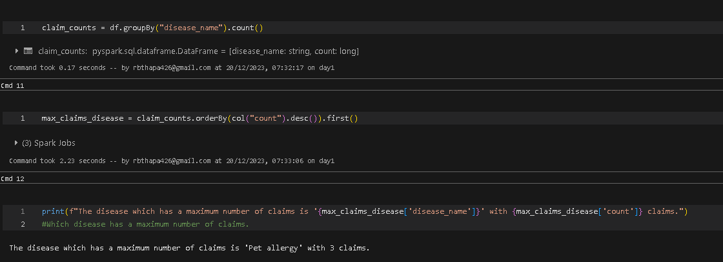
Use Cases
Use case 1 : Which disease has a maximum number of claims.
Given screenshot represents the use case 1

Slide 12
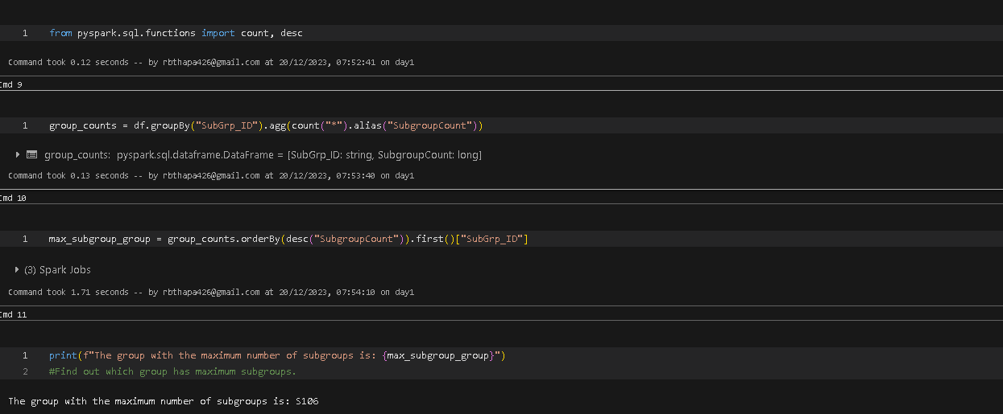
Use Cases
Use case 3 : Find out which group has maximum subgroups.
Given screenshot represents the use case 3

Slide 13
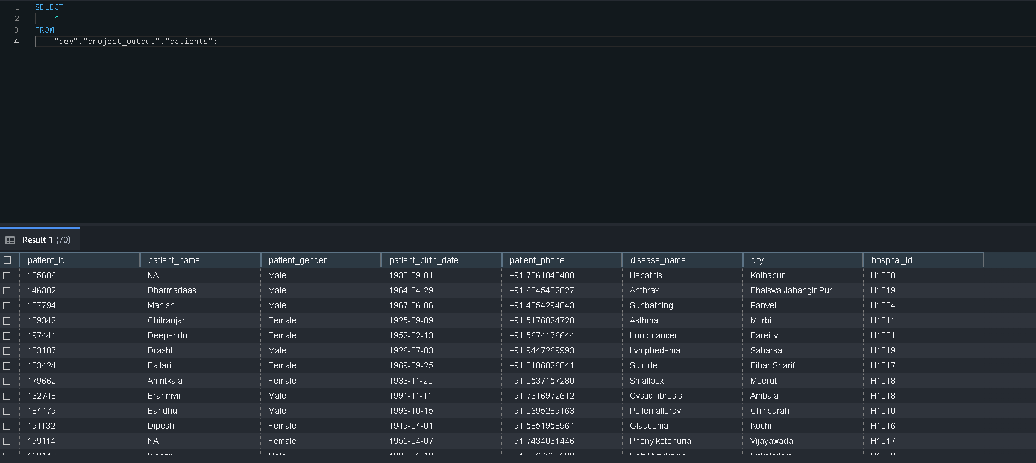
Upload to redshift
Screenshot below represents the cleaned data of patients uploaded to redshift from Databricks

Slide 14
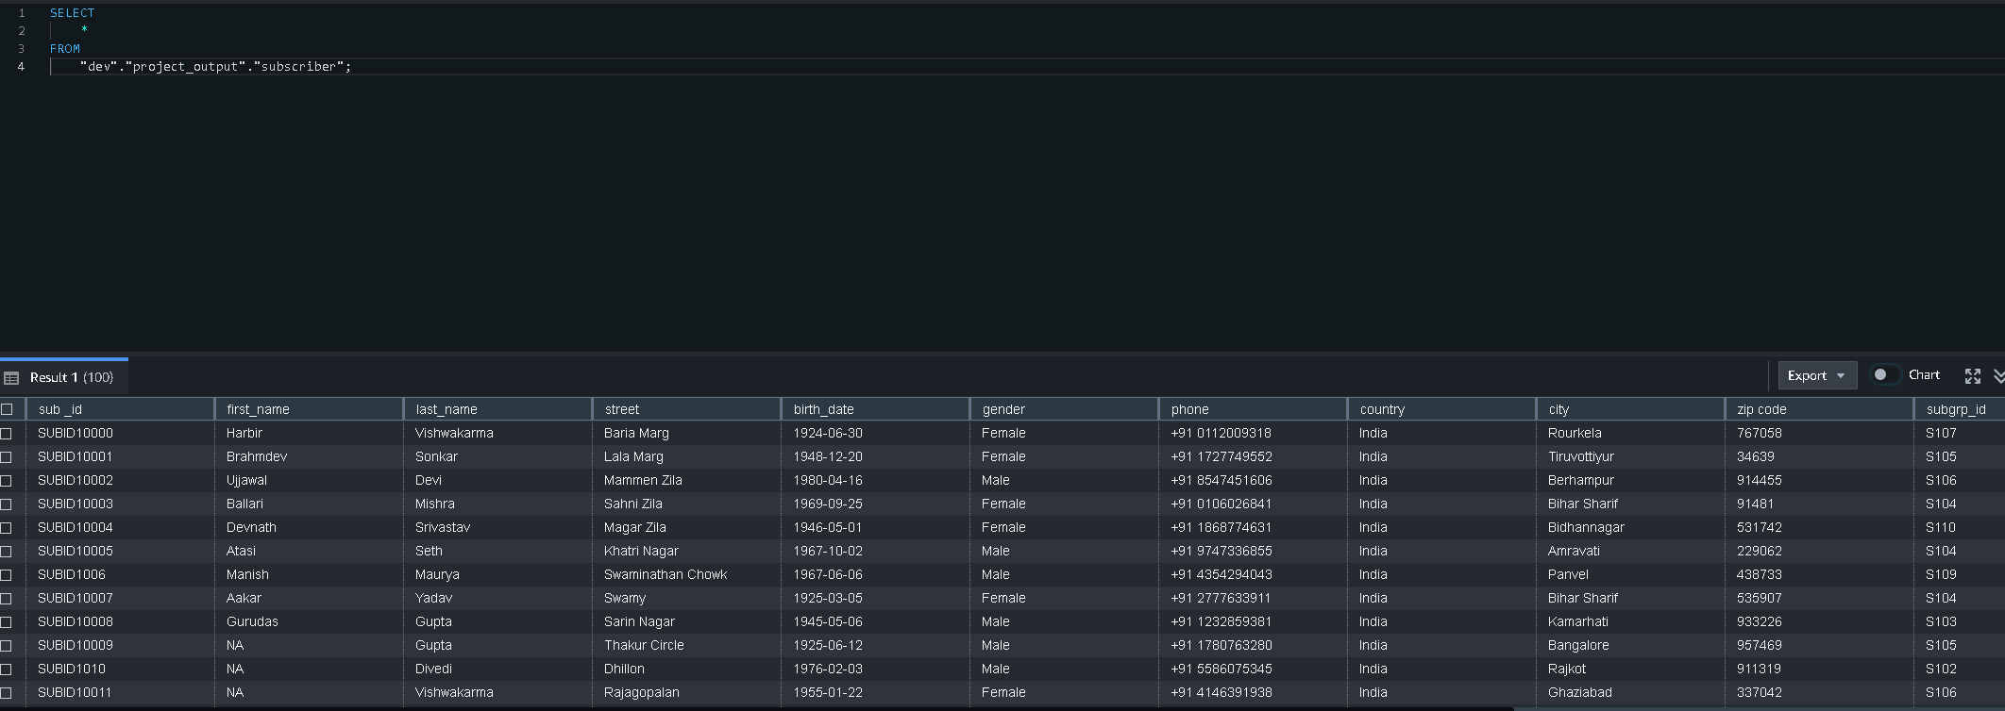
Upload to redshift
Screenshot below represents the cleaned data of subscriber uploaded to redshift from Databricks

Slide 15
Dataframe to write to S3 from databricks
Given screenshot presents the dataframe that writes file from databricks to redshift under schema project_output

Slide 16
Thank You

